Slide 1
ApeRobot
Documentation

Slide 2
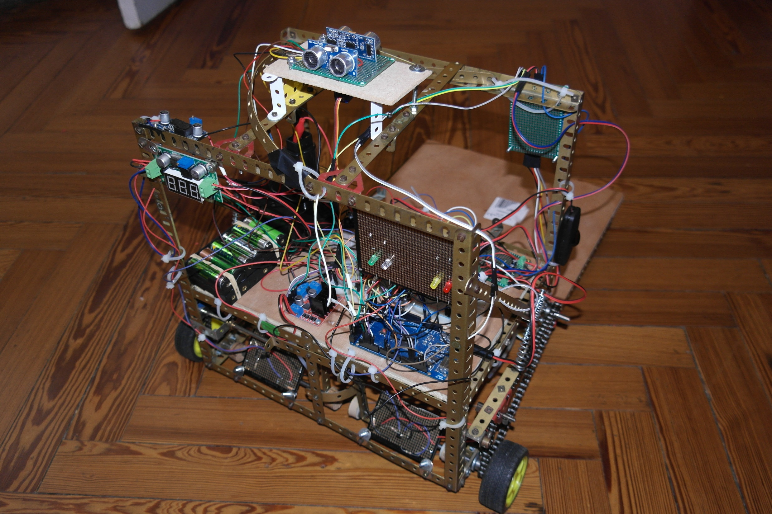
HarDware
ApeRobot Documentation
ApeRobot Documentation
HarDware

Slide 3
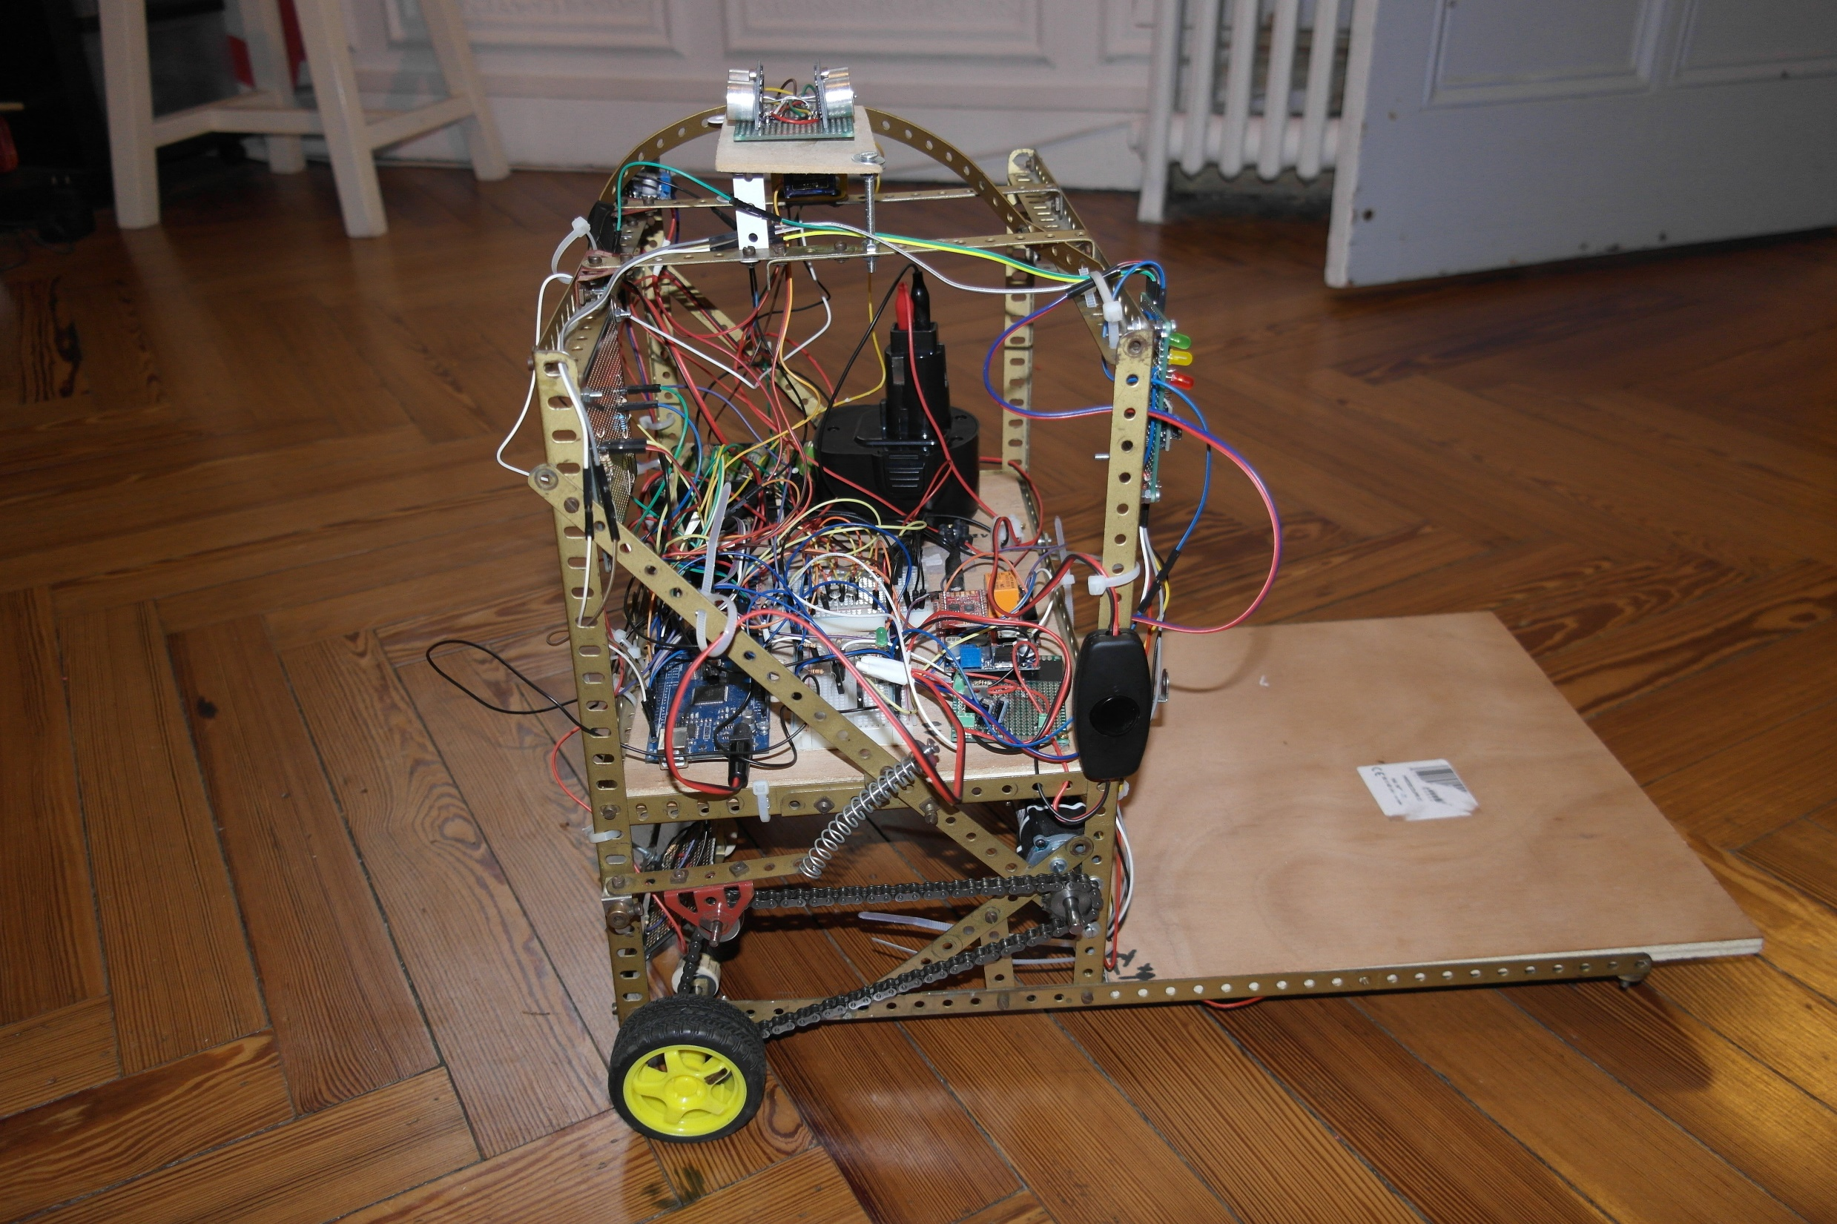
Echo system
Electronic
Moving system

Slide 4
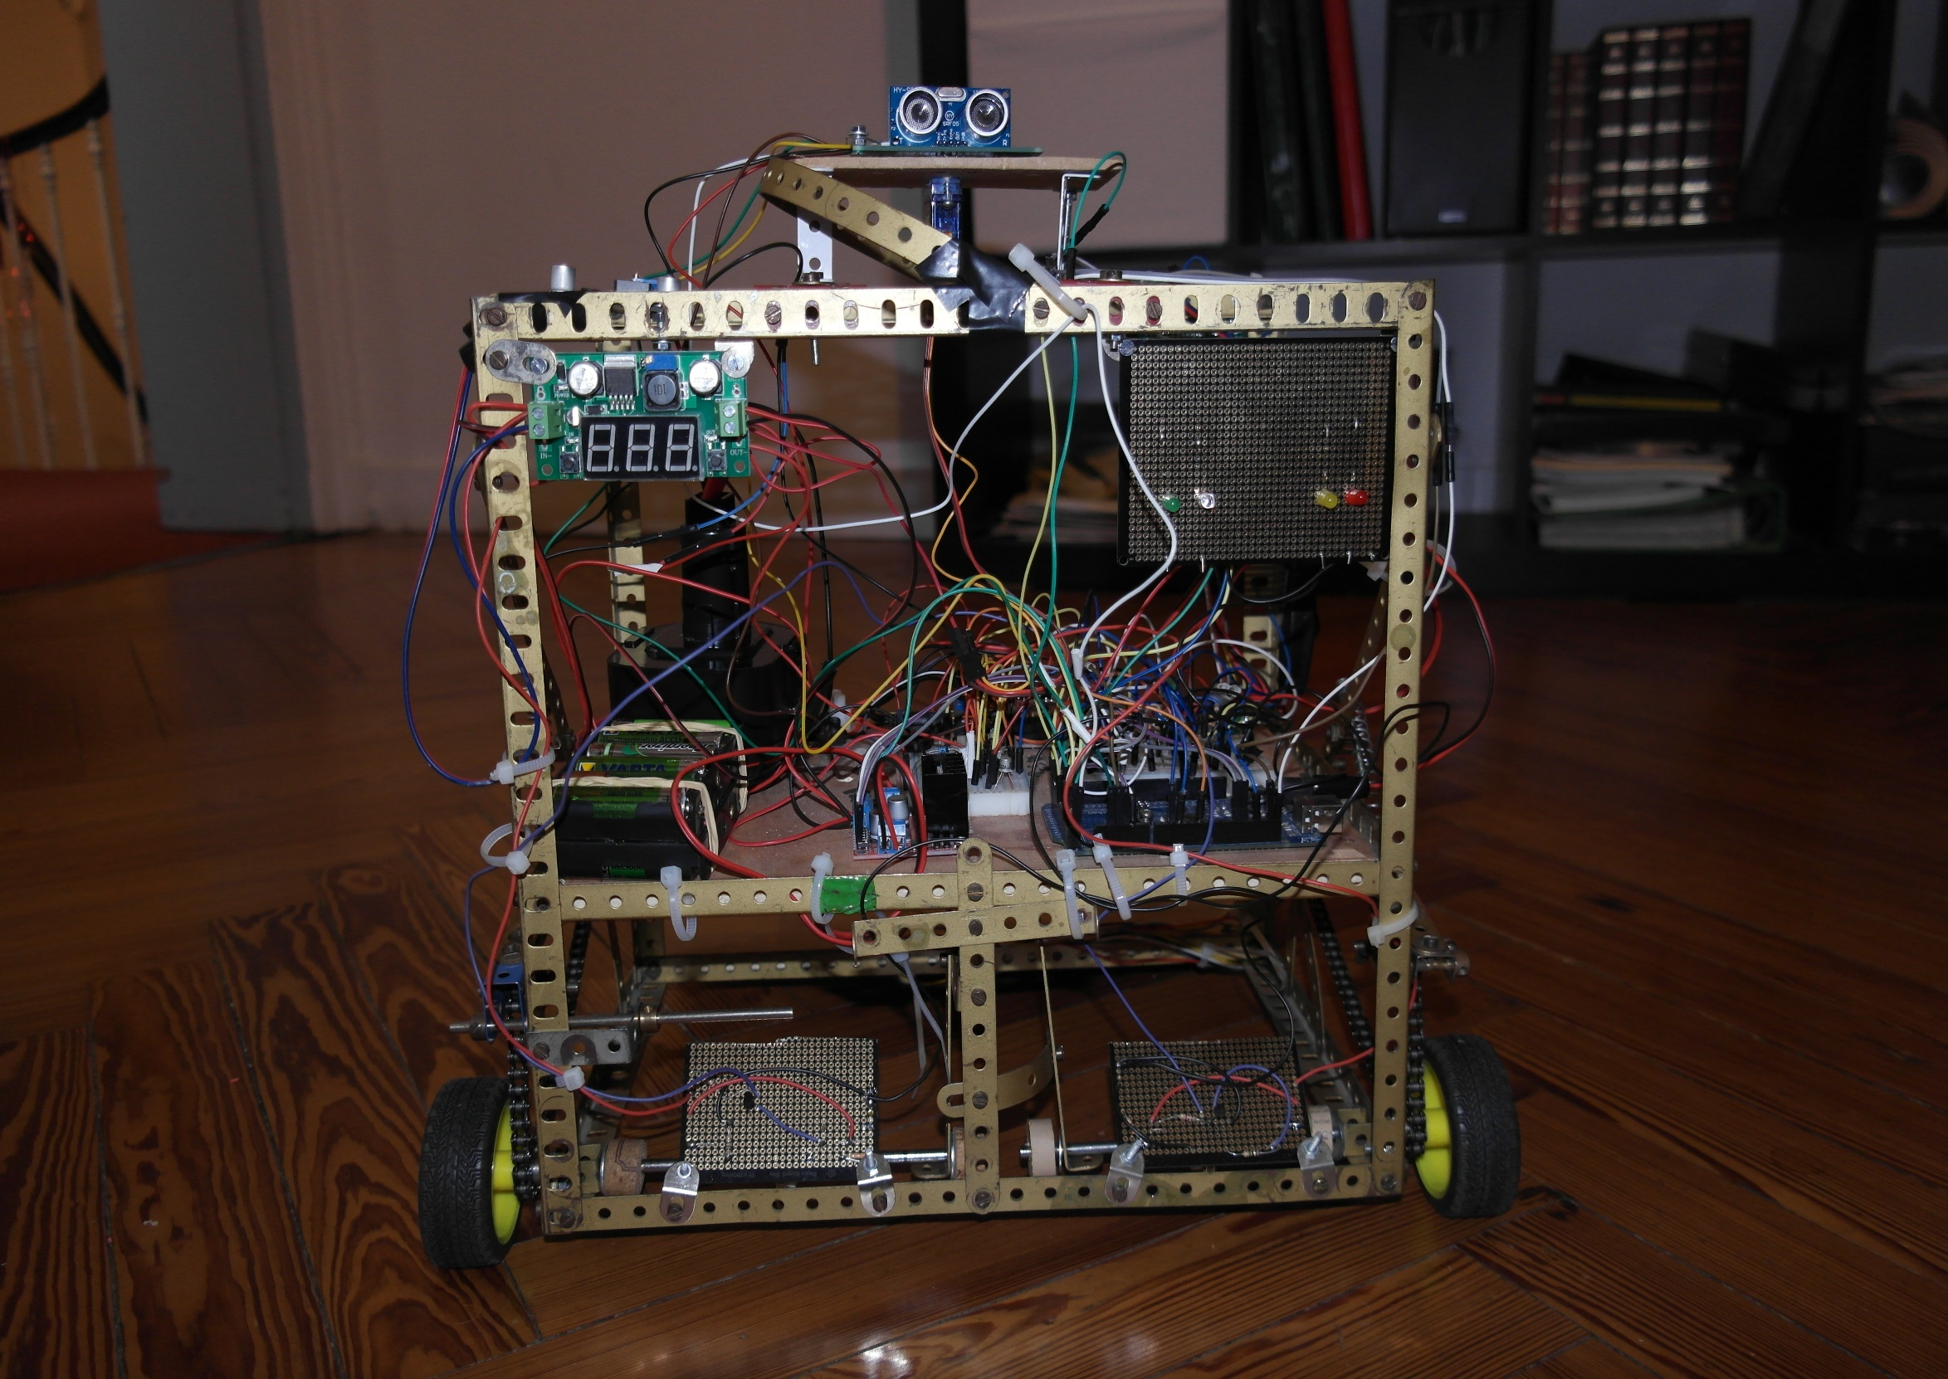
Robot LED
Network LED
Motion LED
Motors Voltage Regulator
Electronic Power LED
Motors controler
Wheel control system

Slide 5
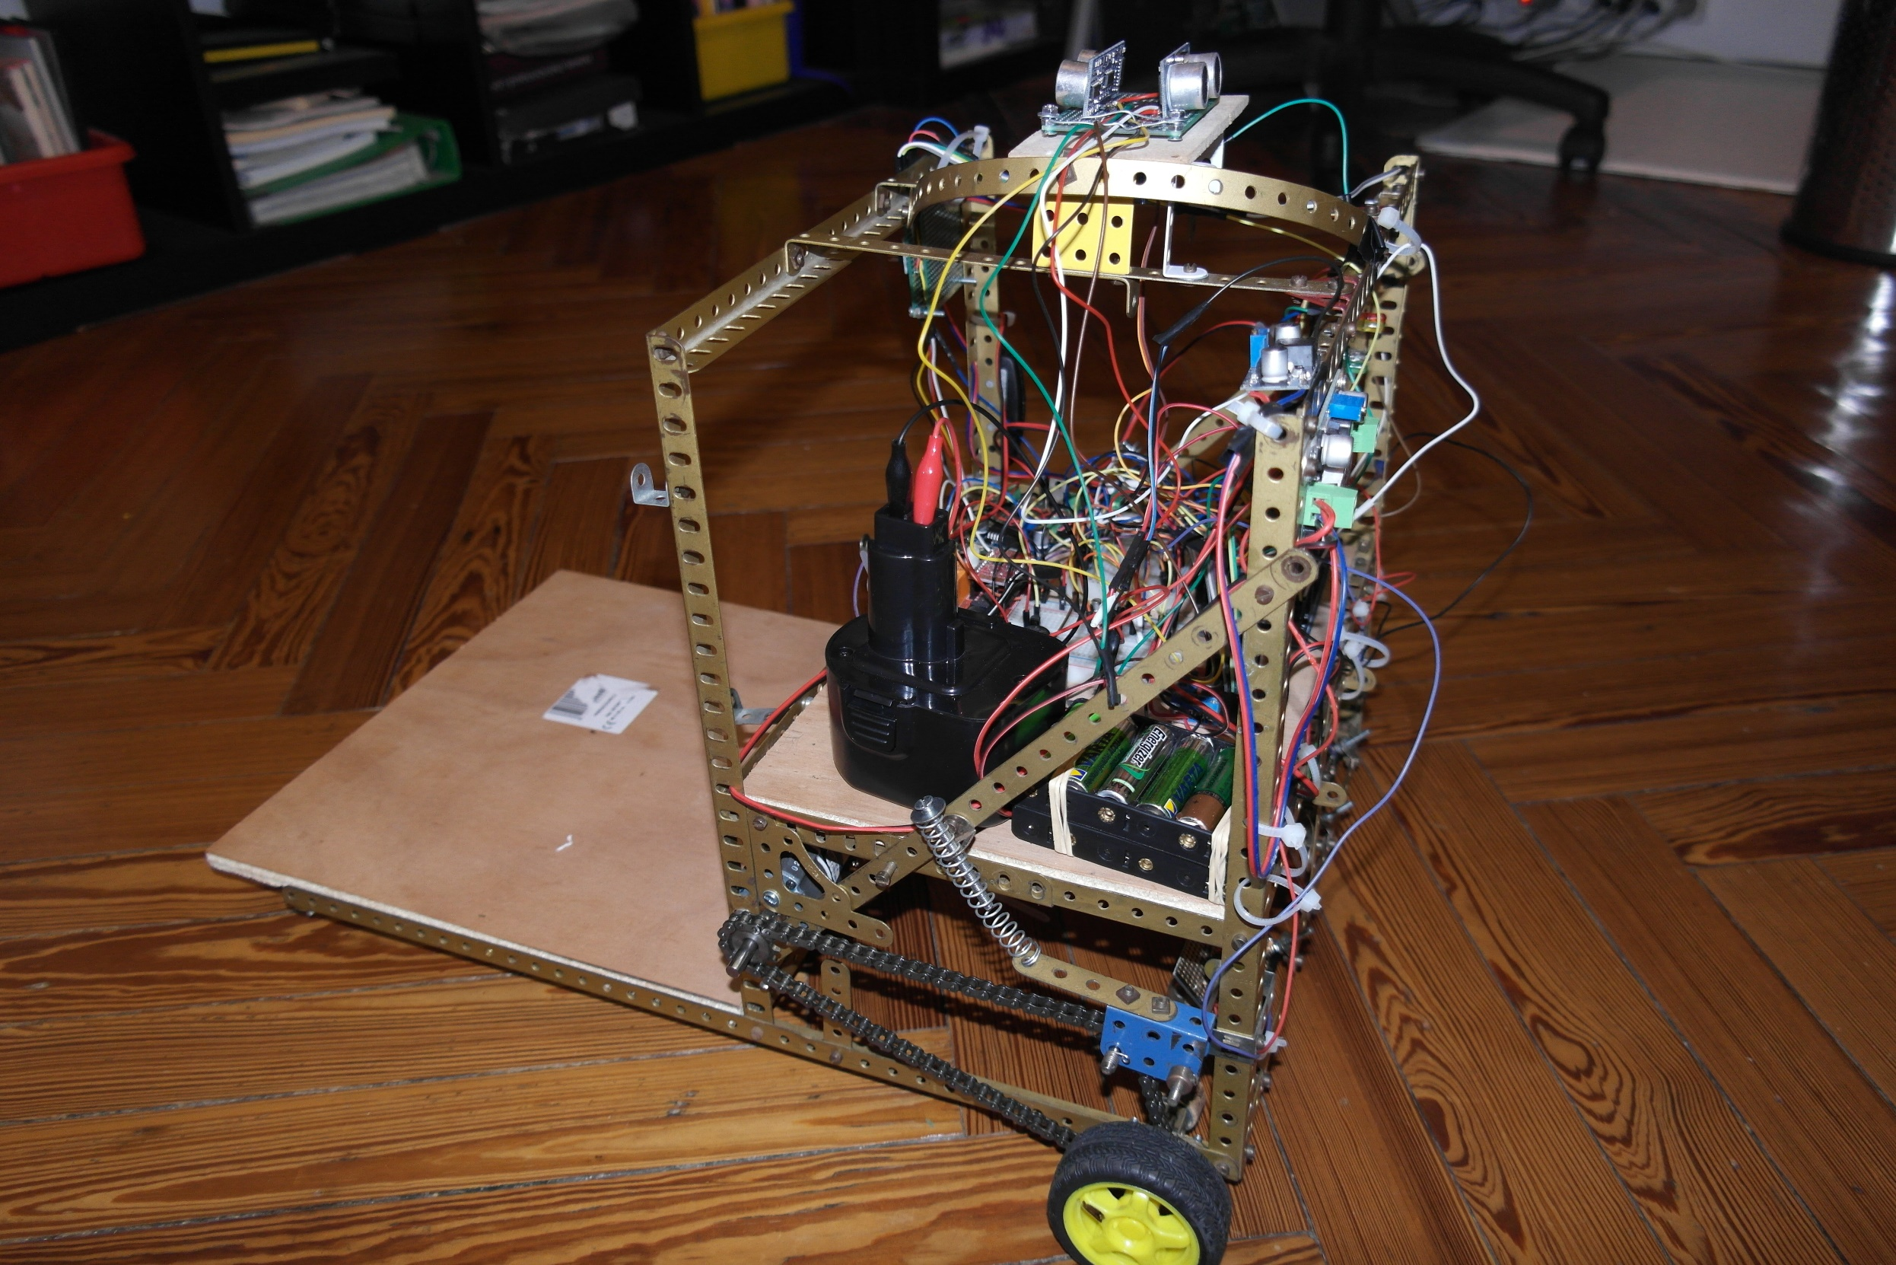
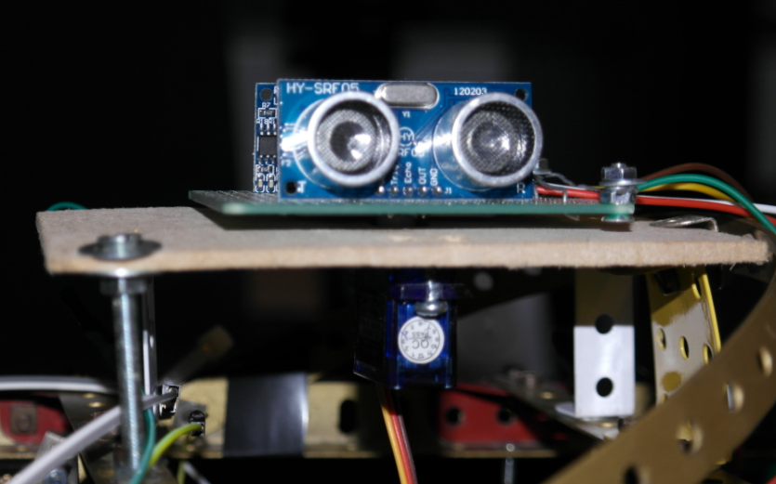
Servo-motor
Echo system
Electronic Battery
Motors Batteries
Left motor
Chain-adjuster

Slide 6
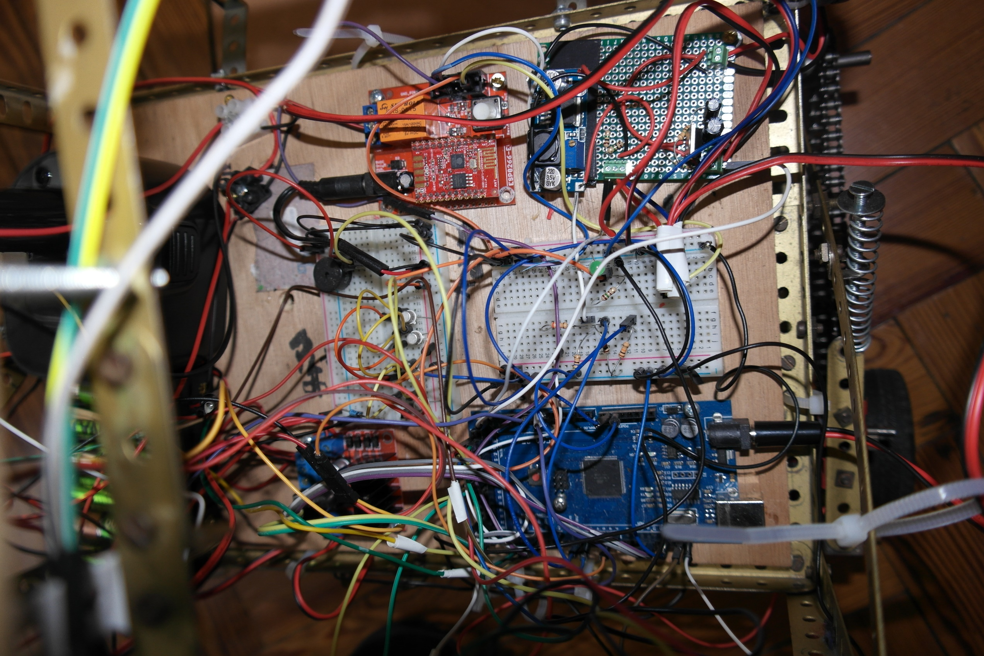
9V Power regulator
WIFI Gateway
Motors power relay
5V Power regulator
Arduino ATMega

Slide 7
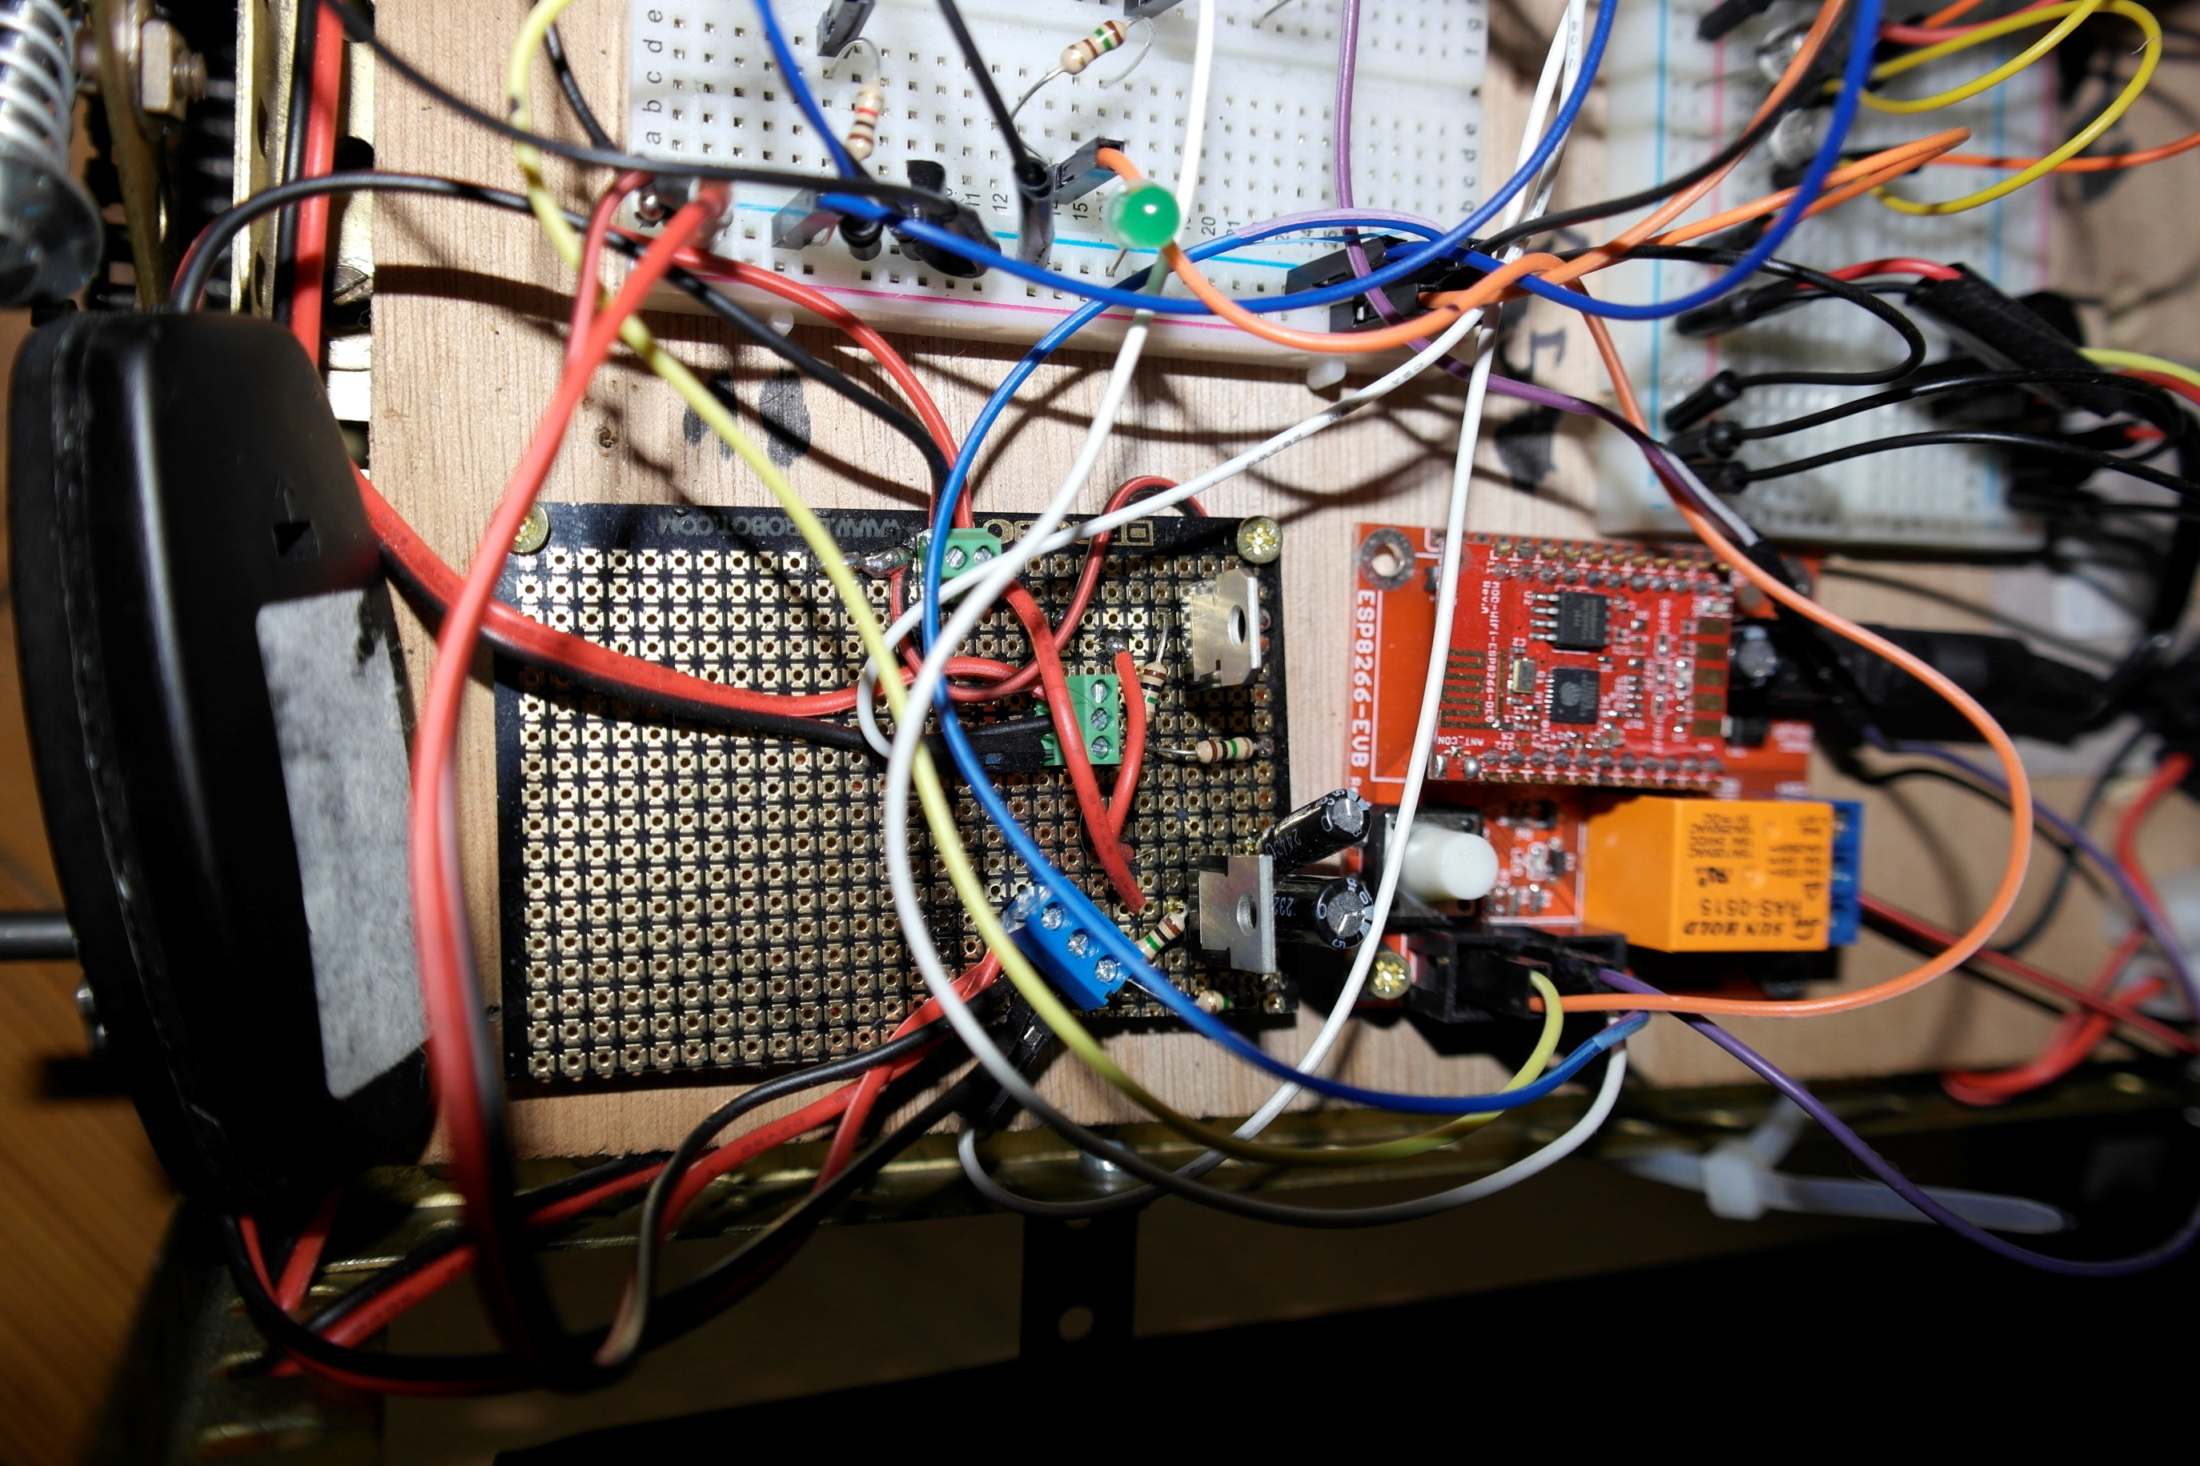
WIFI Connection LED
ESP8266
9v regulator
5v regulator
WIFI LED wire
Ground wire
Serial transmit wire
Serial receive wire
Network trace wire

Slide 8
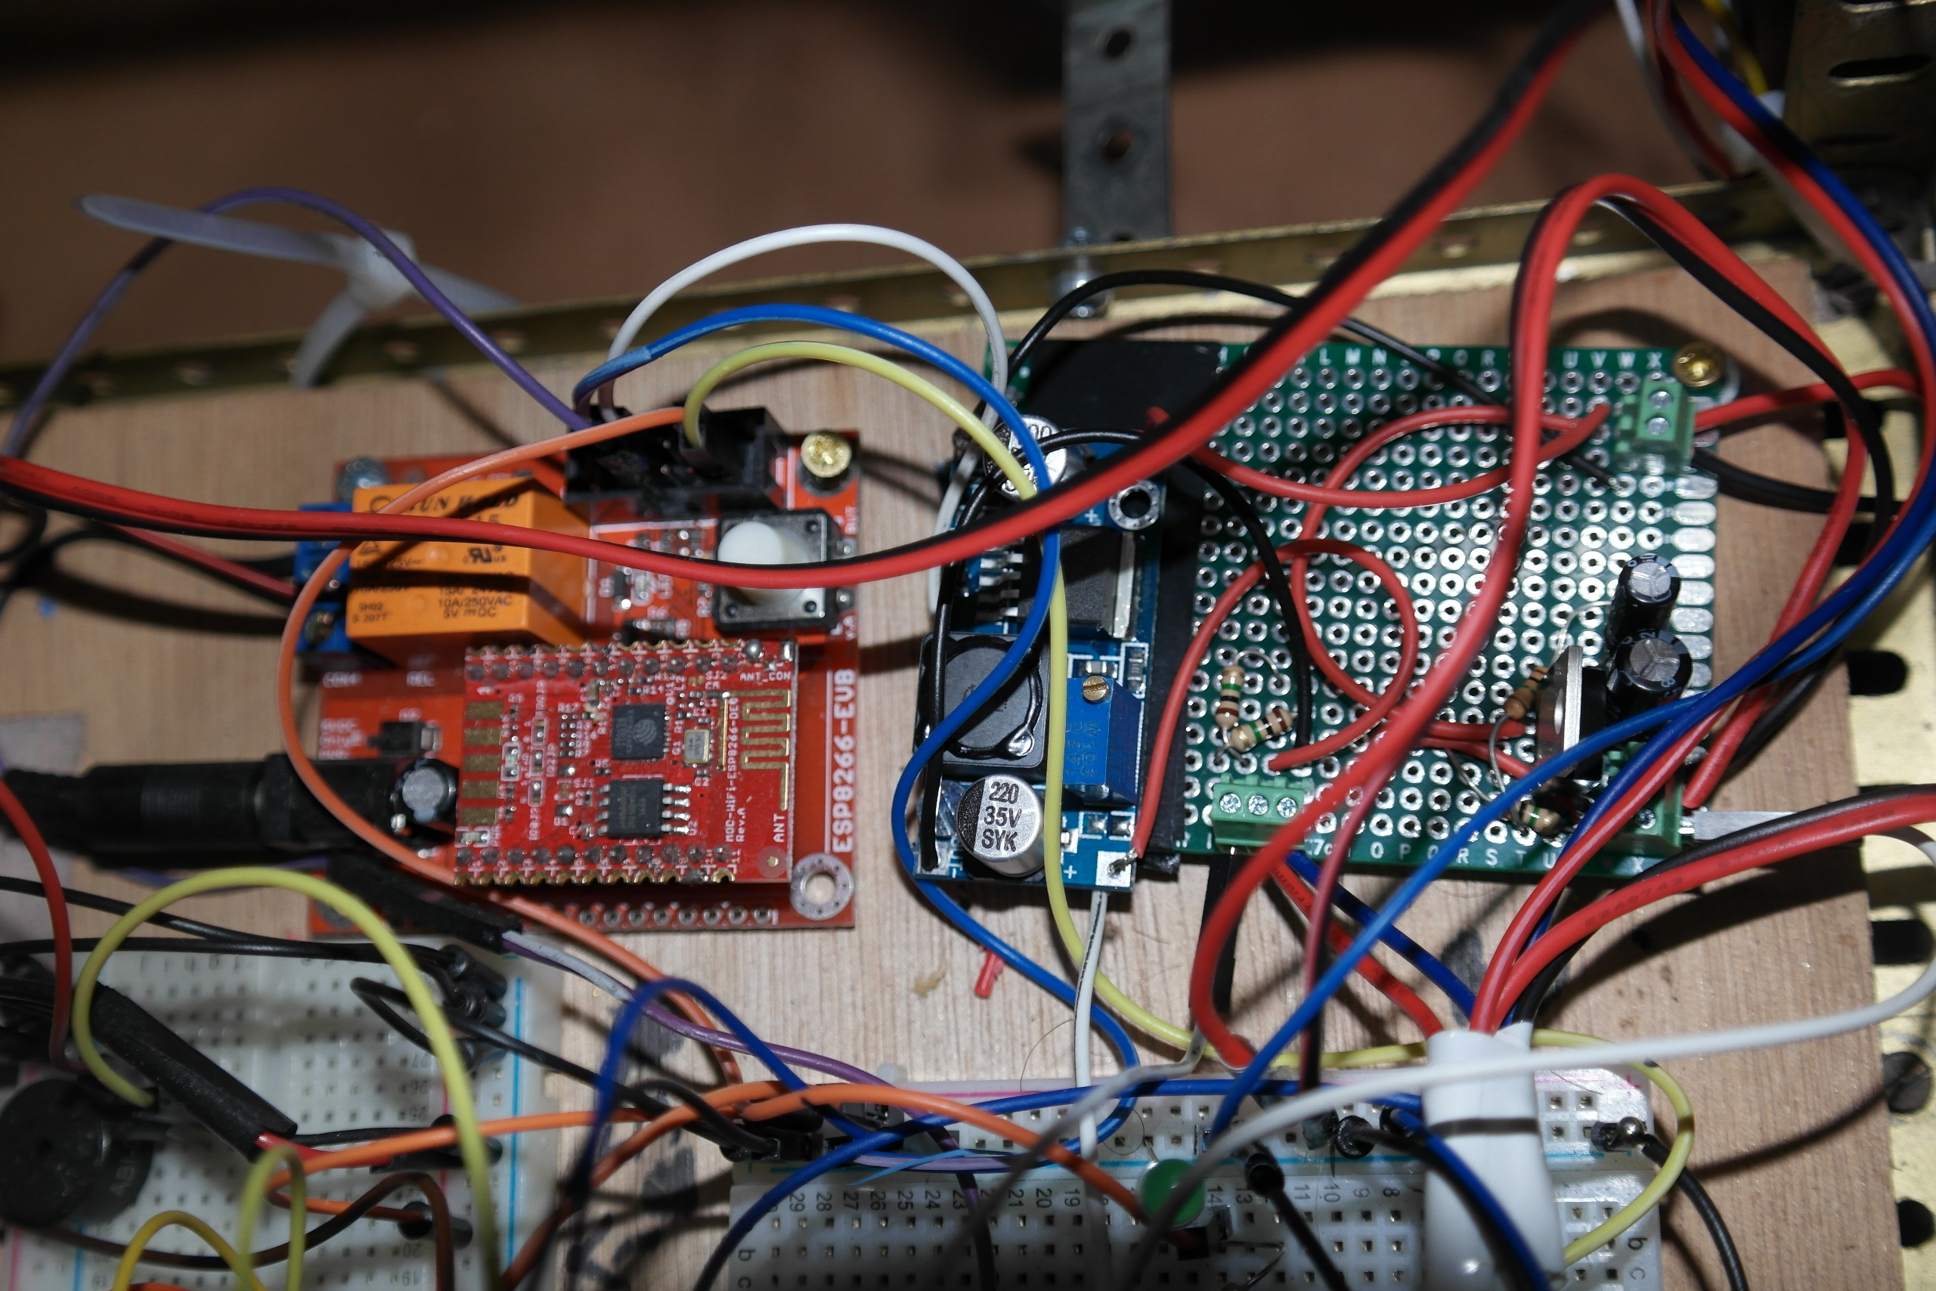
9v regulator
5v regulator
Serial receive wire
Serial transmit wire
ESP8266
WIFI LED wire
Ground wire
Network trace wire

Slide 9
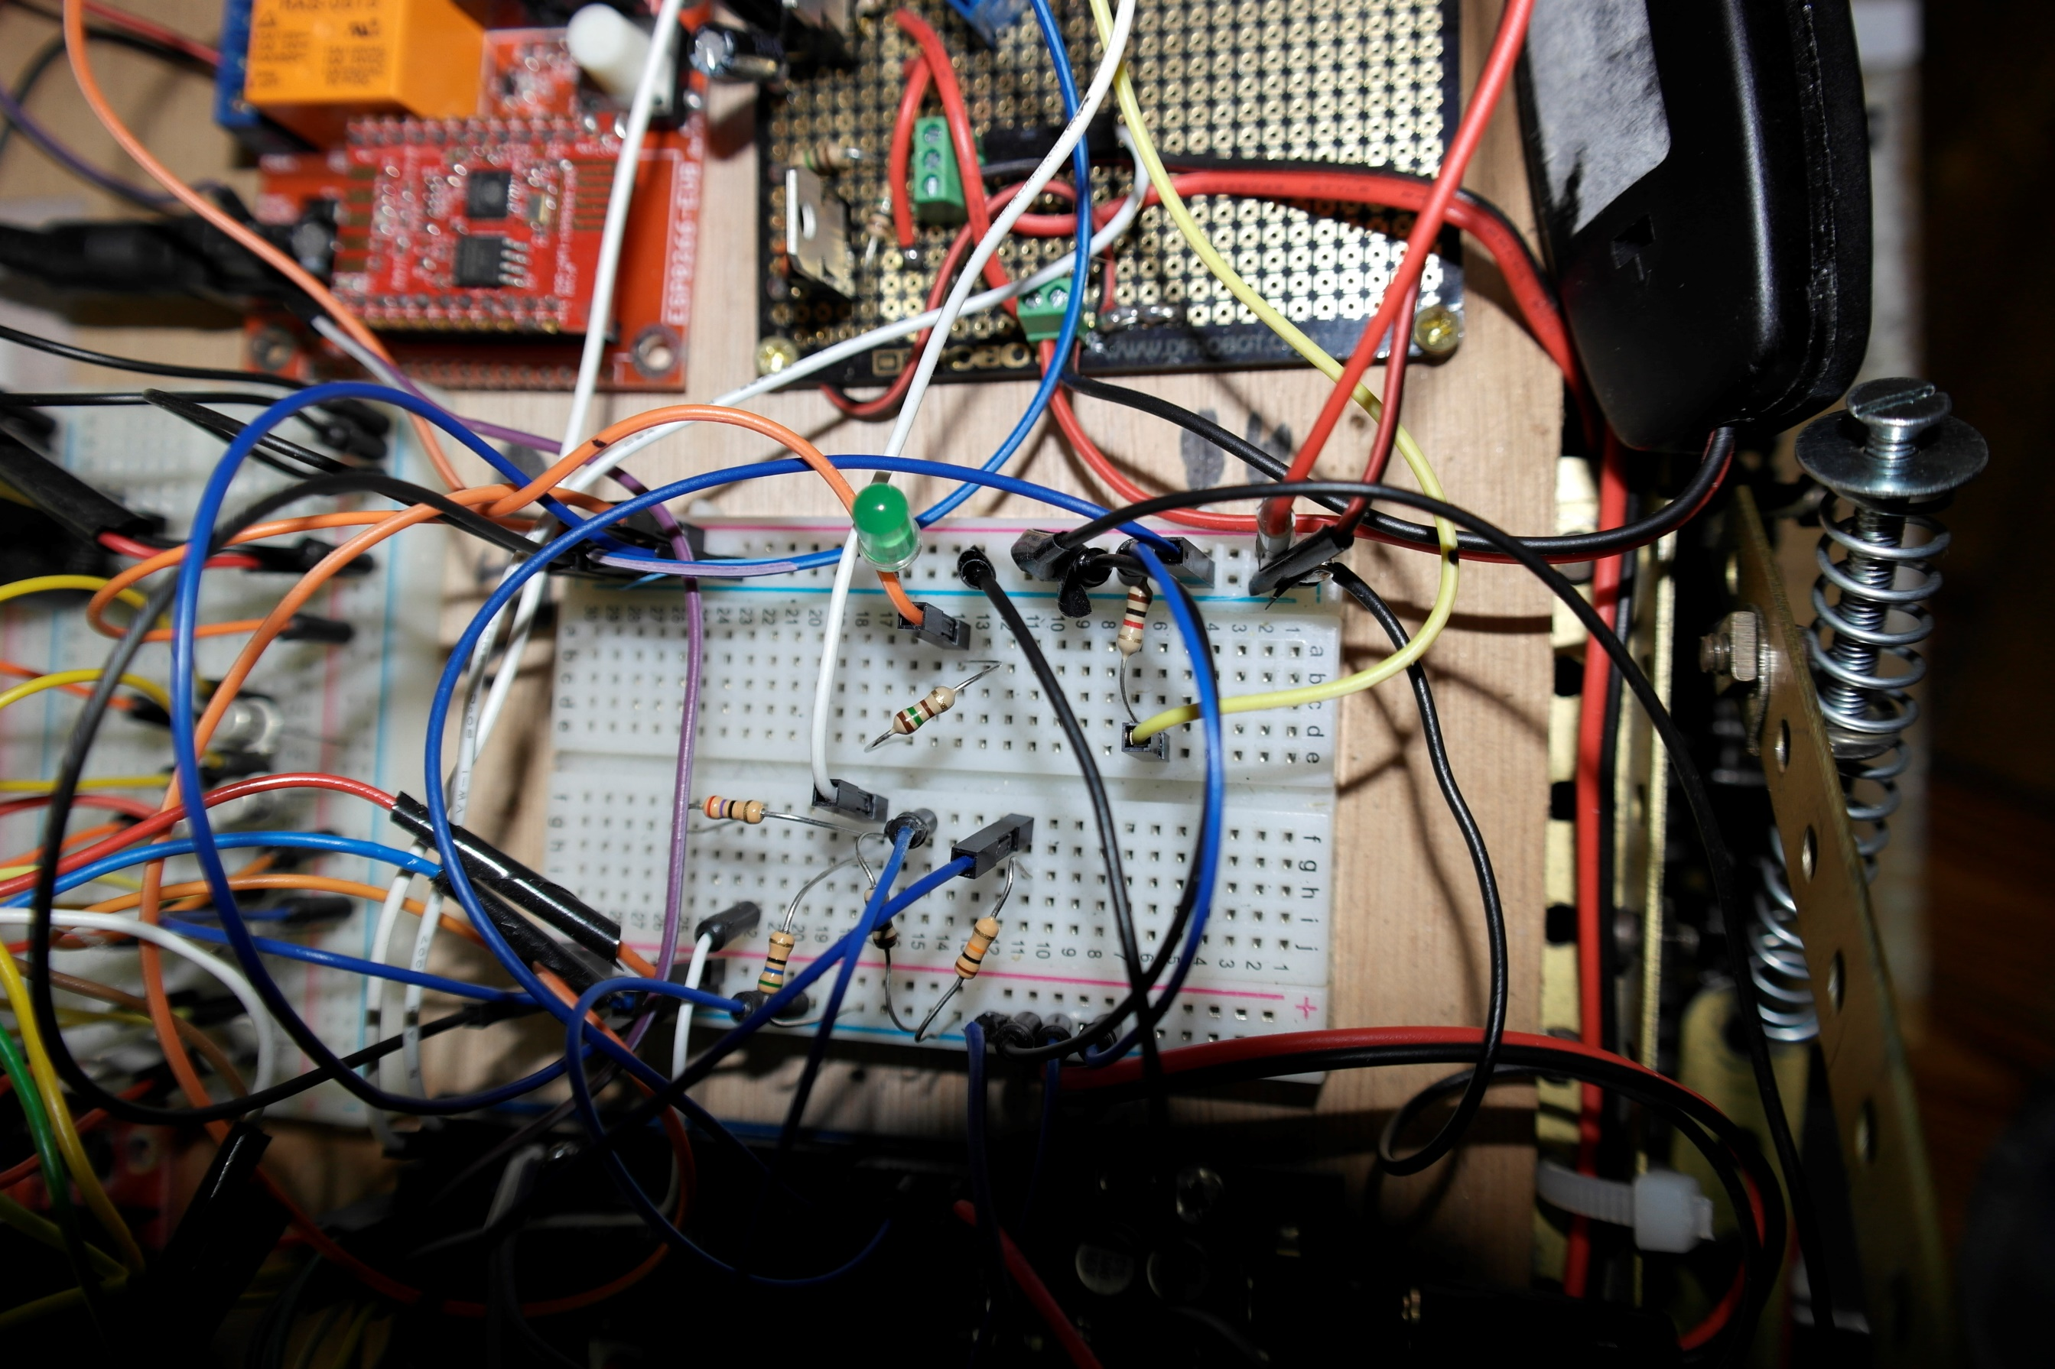
WIFI connection LED
+5 volts
Arduino PIN 3
Arduino PIN 2
LED resistor
Pull down resistor
ESP8266 Serial RD
Unplug to get UDP trace
+5 volts
Voltage devider
ESP8266 Serial RD
Arduino Serial TD
Pull down resistor
10k
Pull down resistor

Slide 10
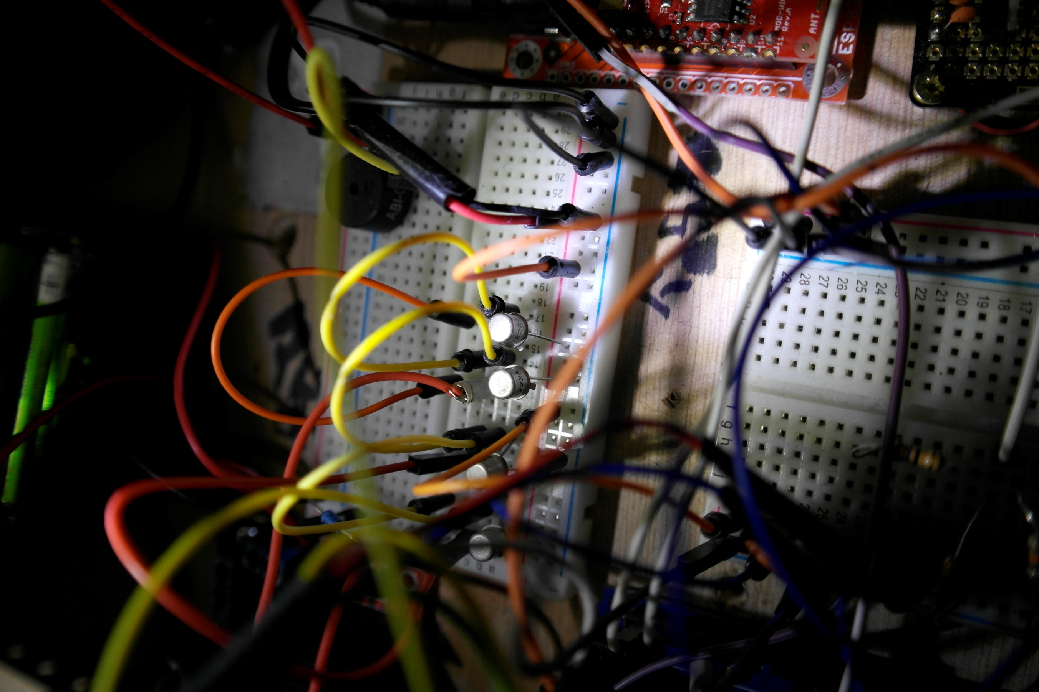
Left encoder power switch system
+5 volts
Left encoder power
Arduino encoder power PIN
Right encoder power switch system

Slide 11
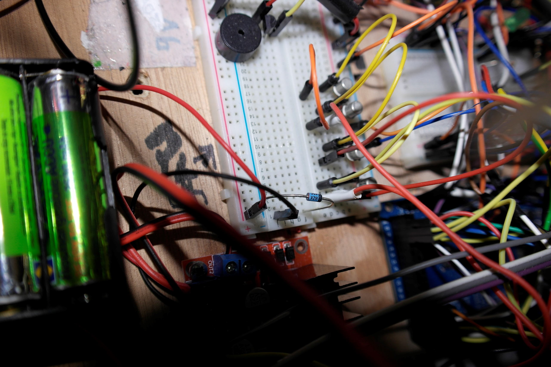
+12 volts
Motor controler ground
Left encoder power
Zener diode

Slide 12
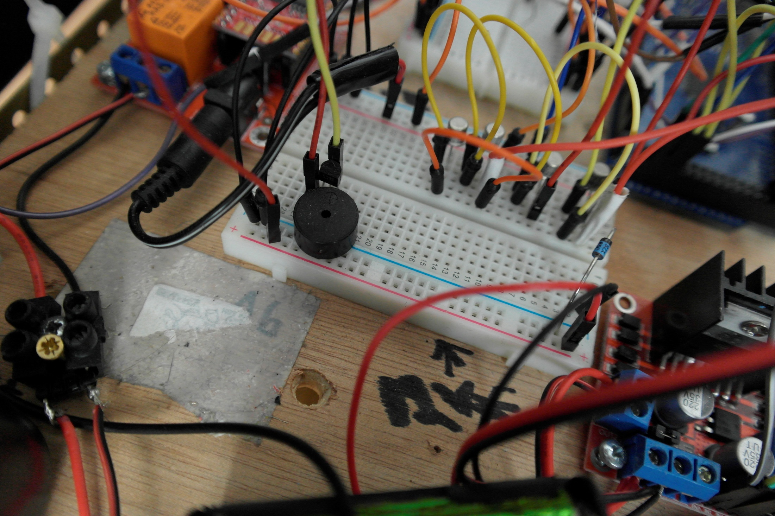
Arduino buzzer PIN
Transistor
Buzzer
Zener diode
+12 volts (motors)
+12 volts (motors batteries)
Ground (motors batteries)

Slide 13
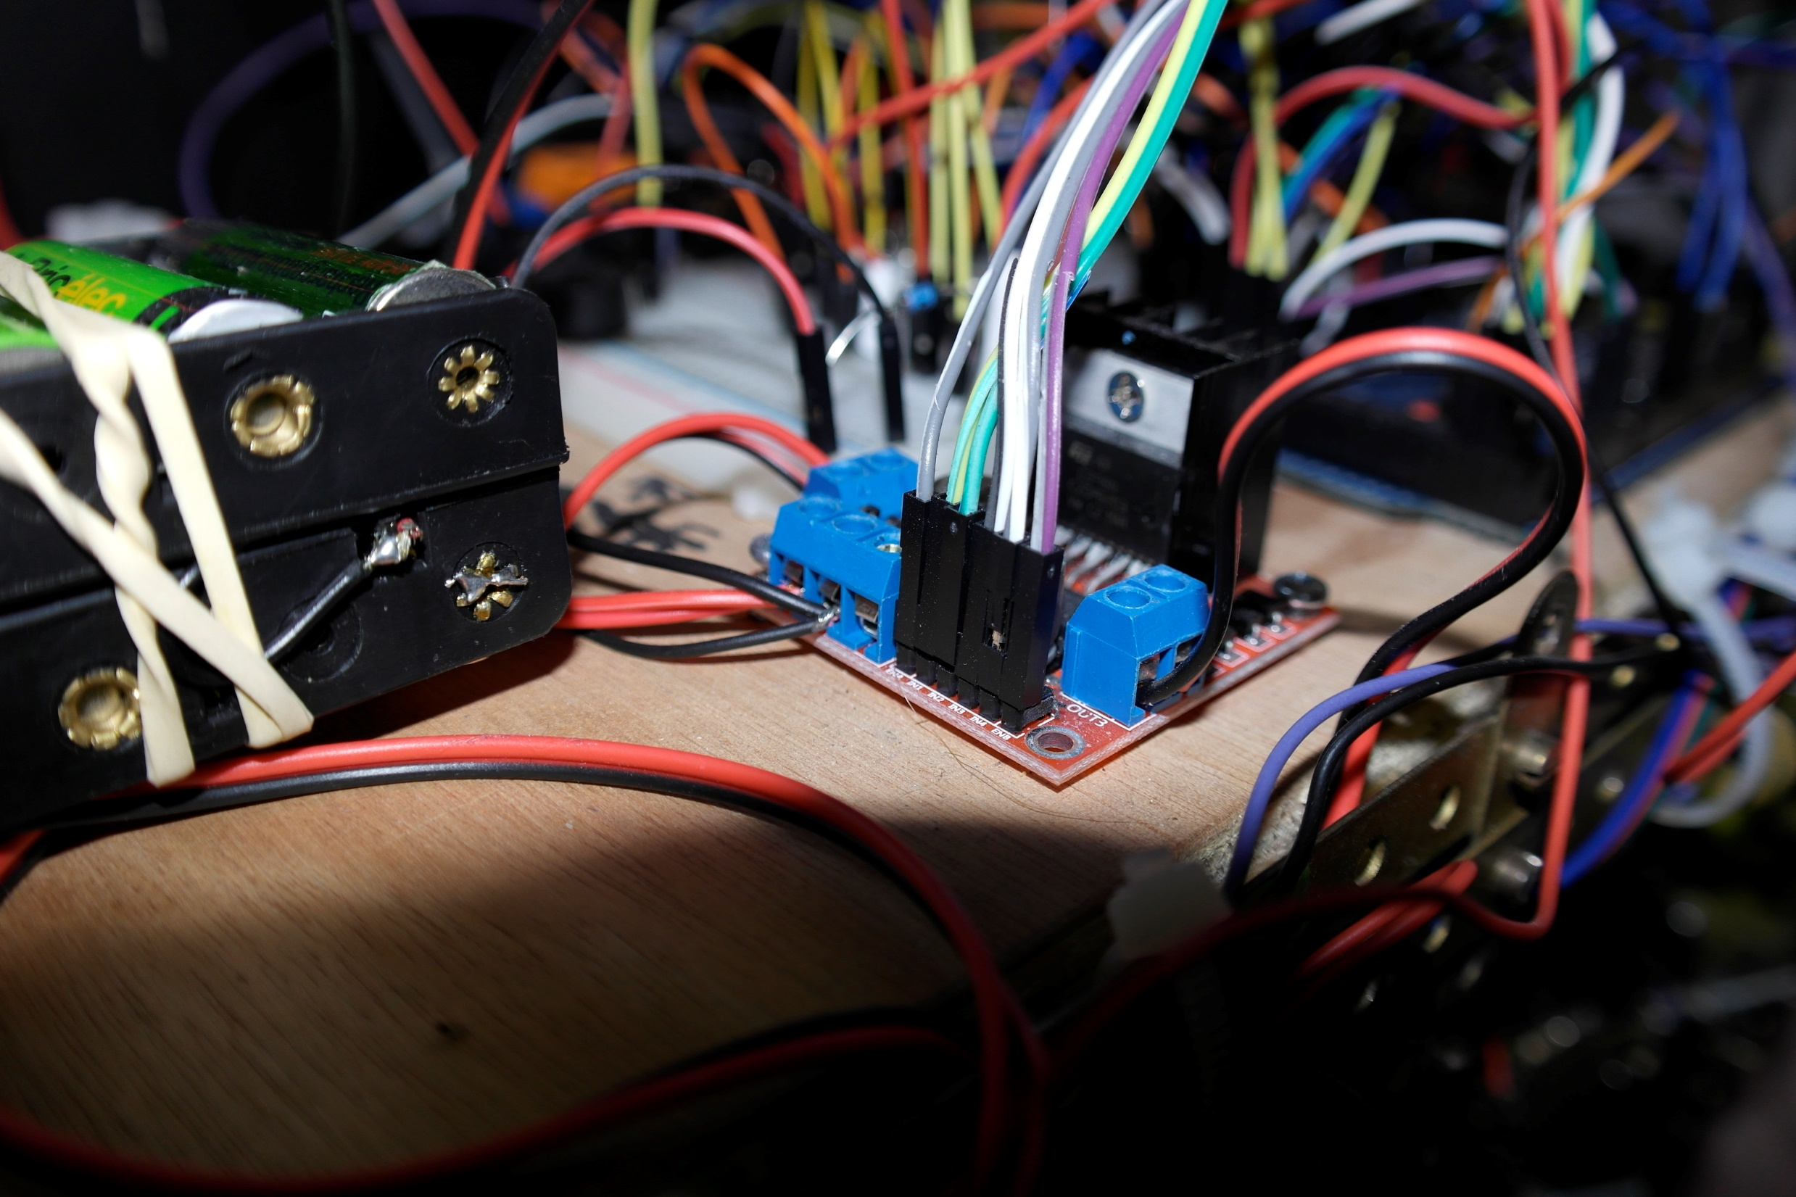
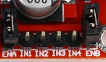
To Arduino Motors PIN
Right motor 12v power
+12v to breadboard
+12v from regulator
Ground
Motors Batteries
Left motor 12v power

Slide 14
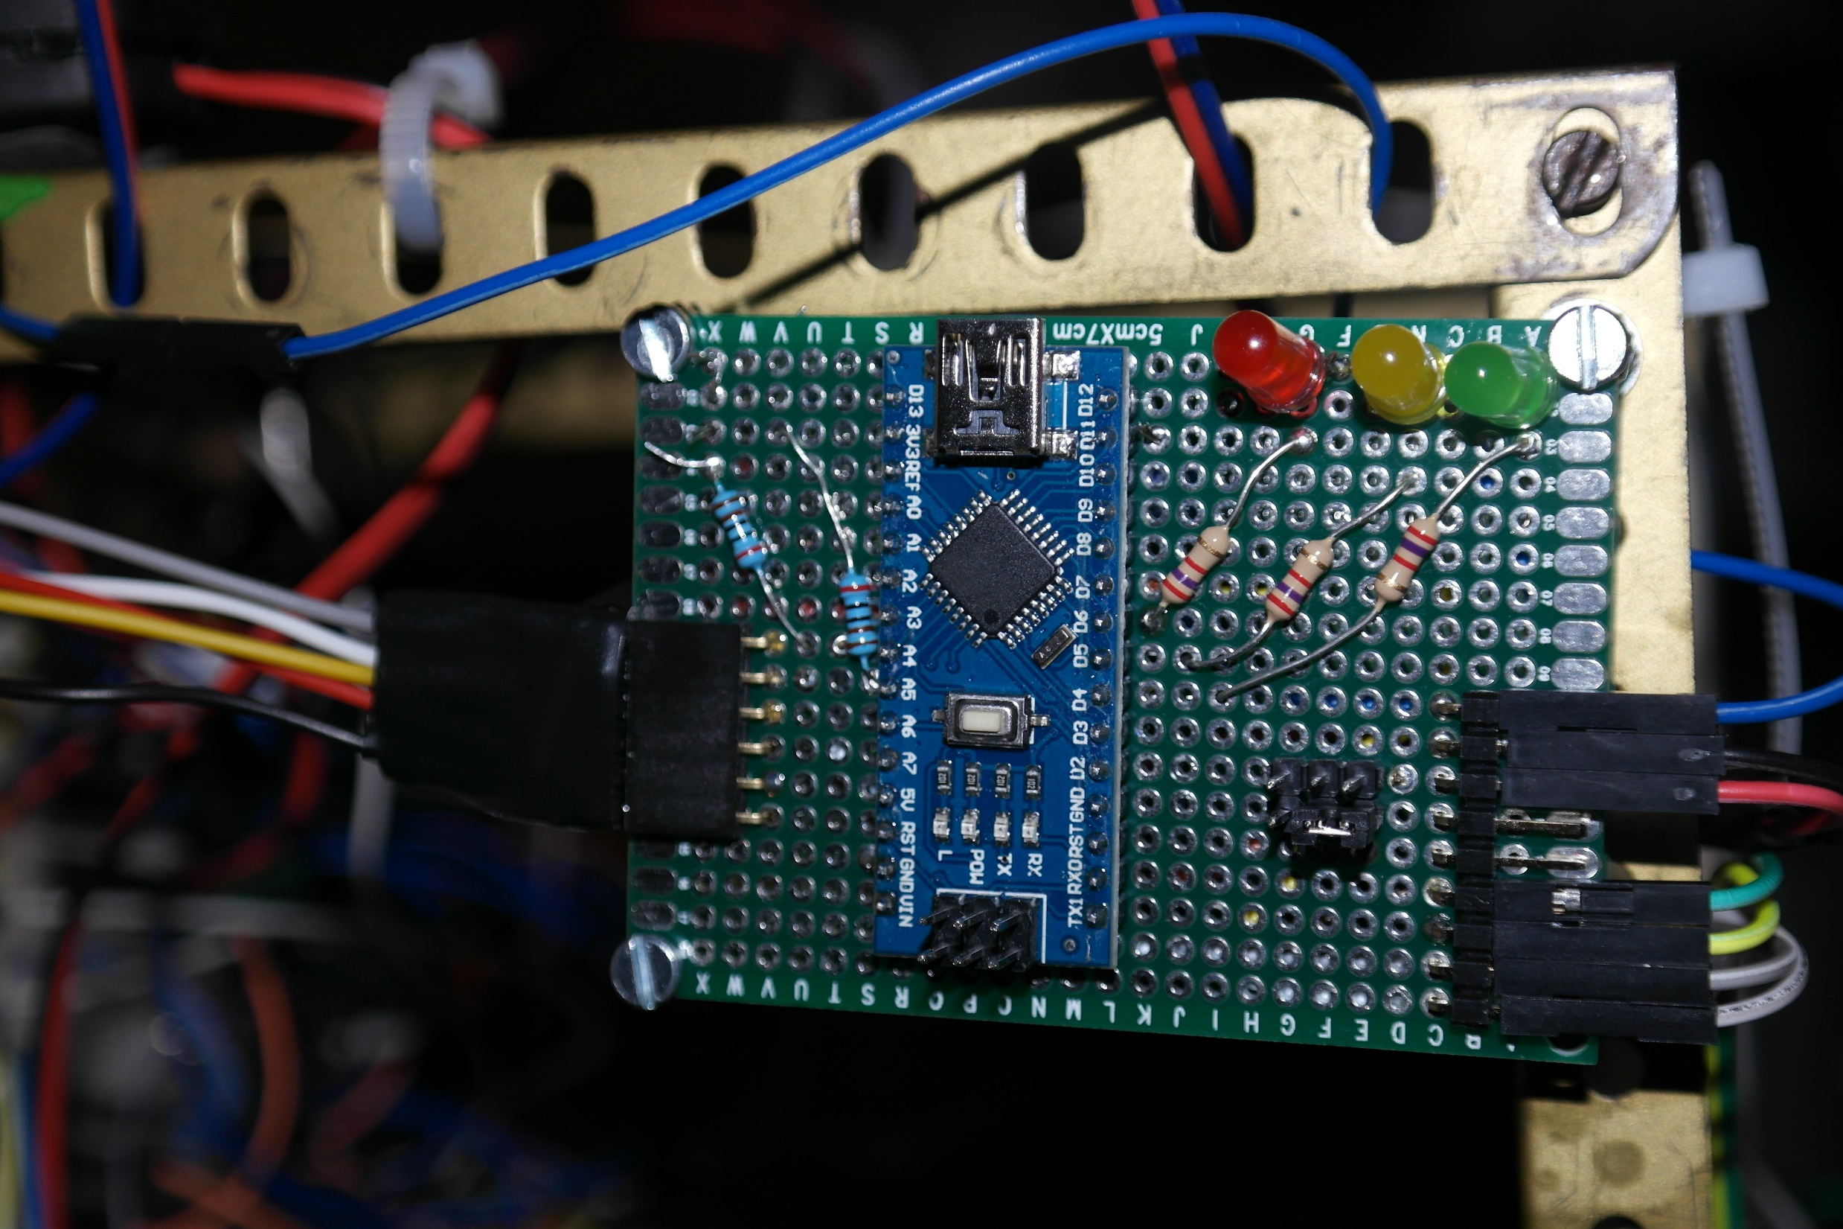
2 x I2C pull-up resistors
3 x LED resistors
Status LEDs
SDA
GND
SCL
GND
BNO Interrupt
Configuration PIN
+5 V
Nano Pin 12
Inertial Motion Subsystem
Nano Pin 11
GND
BNO055 connection
SDA
+5 V
Robot connection
Arduino Nano
SCL

Slide 15
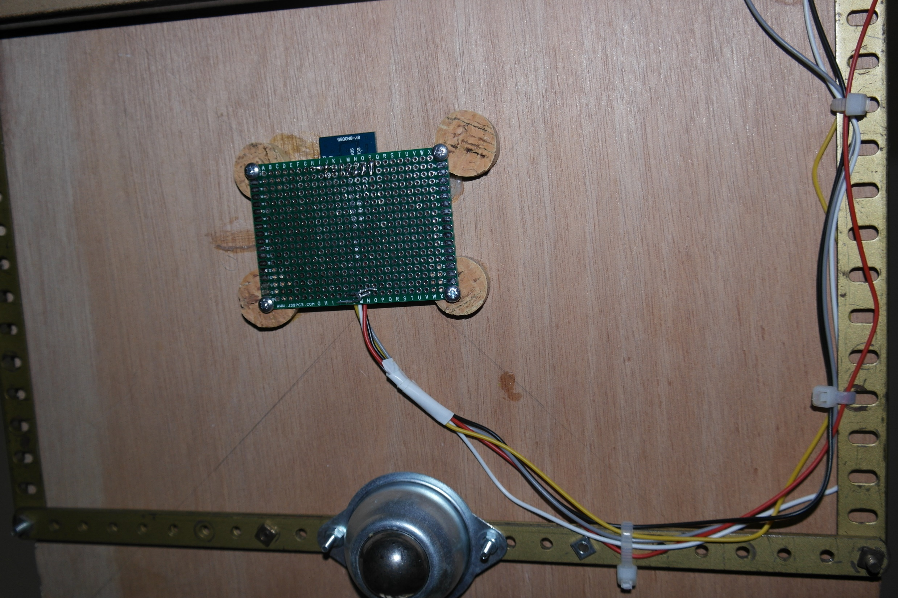
Magnetometer
Ground
BNO Interrupt
SCL
+5 volts
SDA
Free front wheel

Slide 16
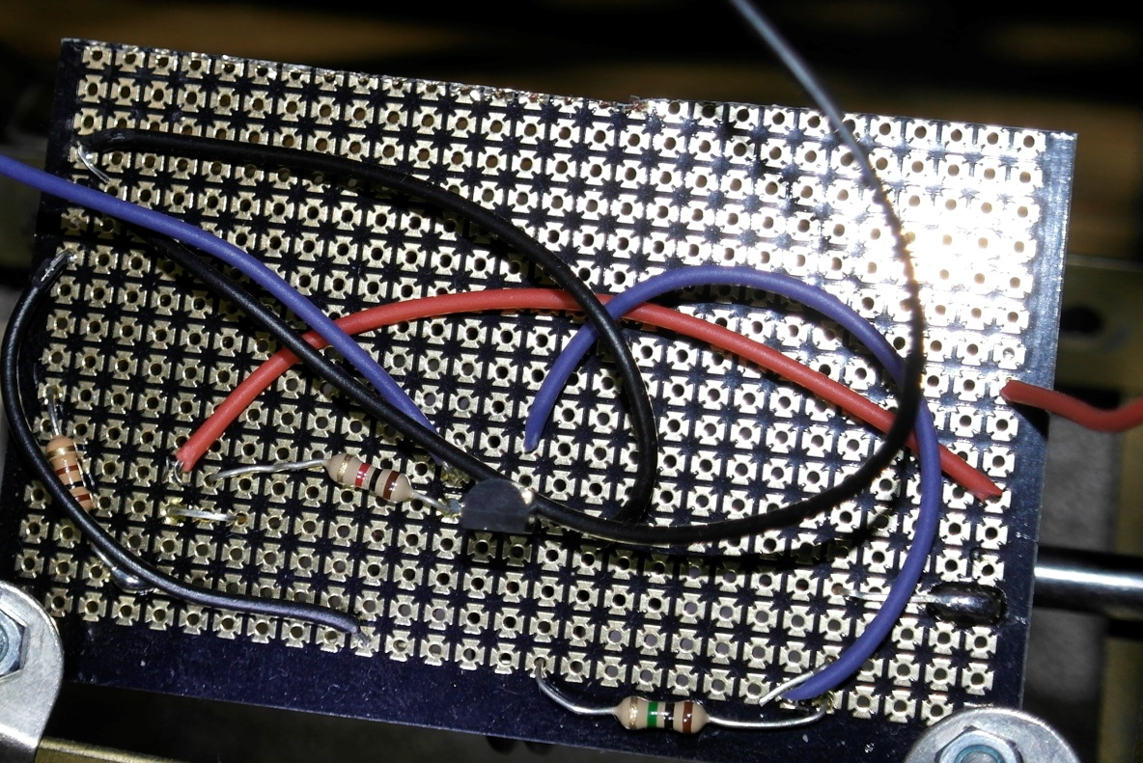
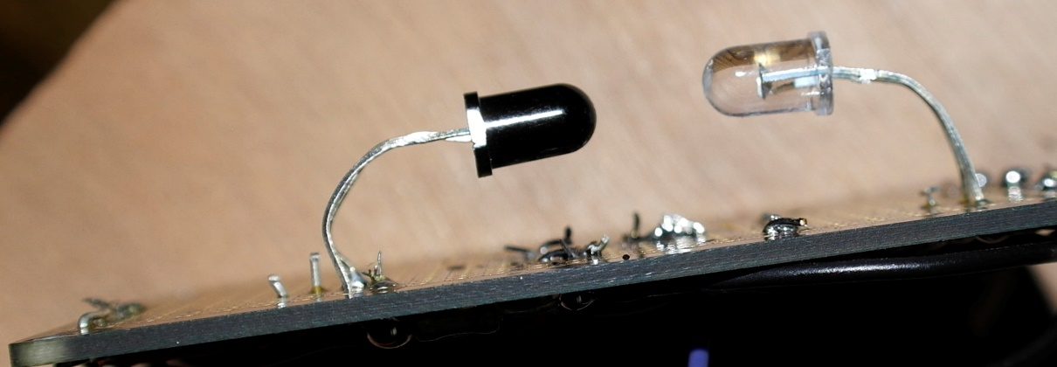
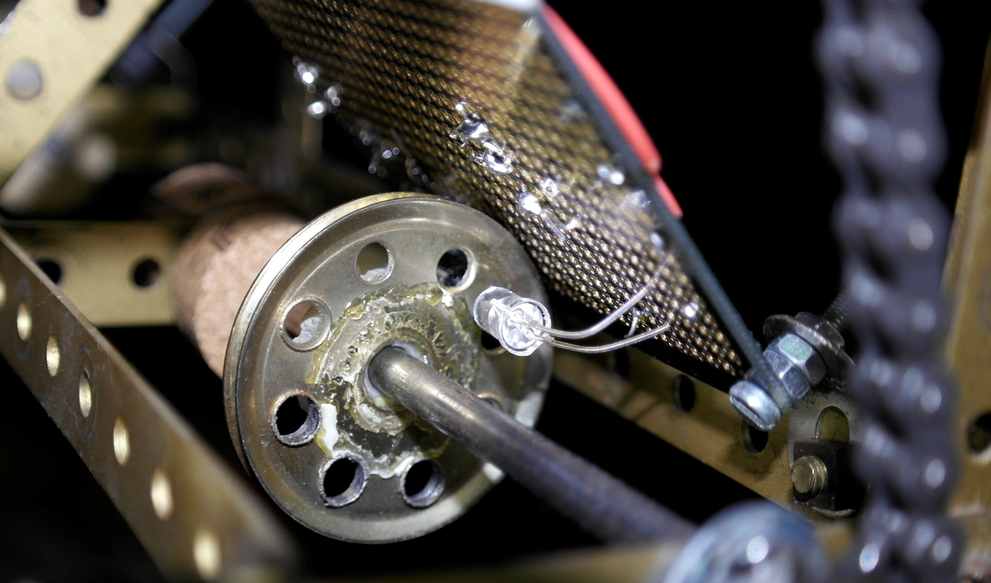
Wheel Encoder Documentation

Slide 17
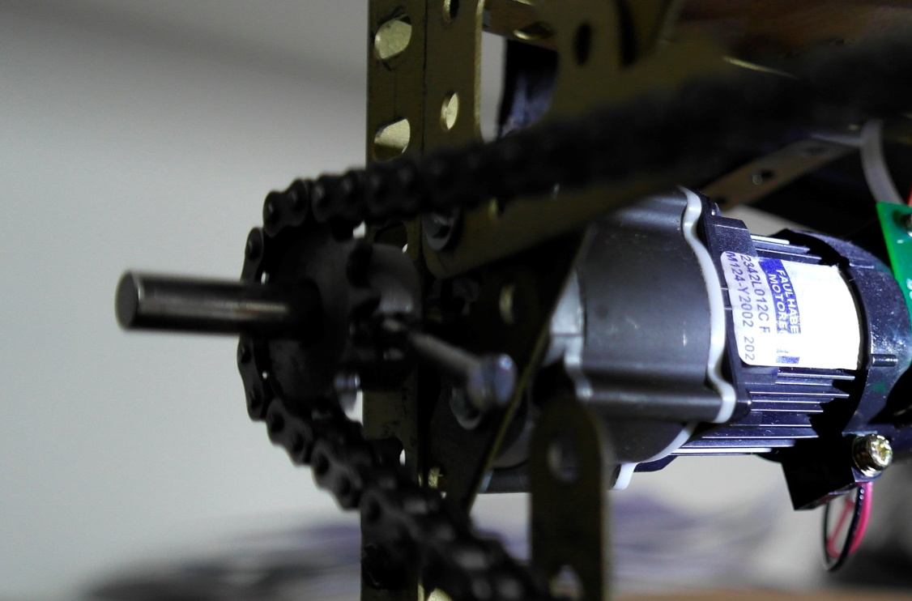
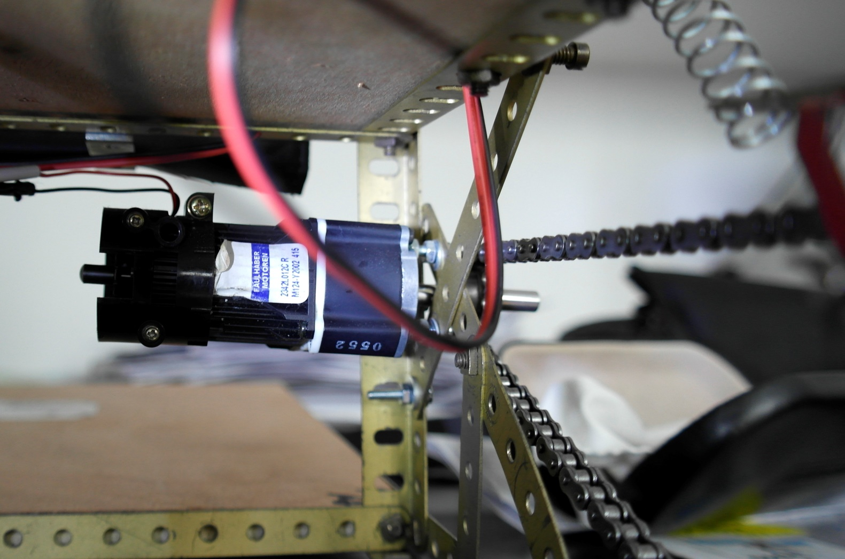
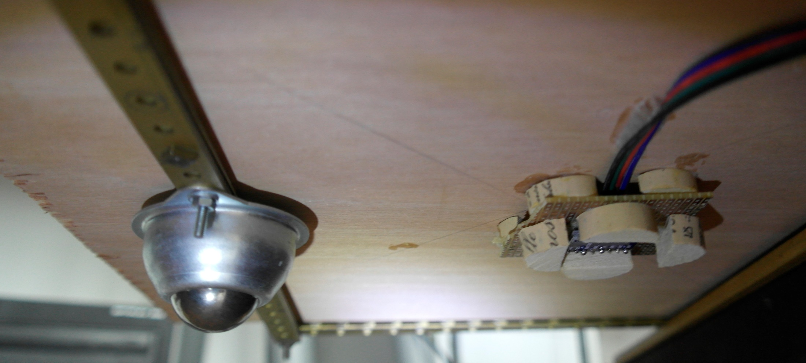
Left motor pinion
Left motor
Right motor
Right transmission chain
Front wheel
Magnetometer

Slide 18
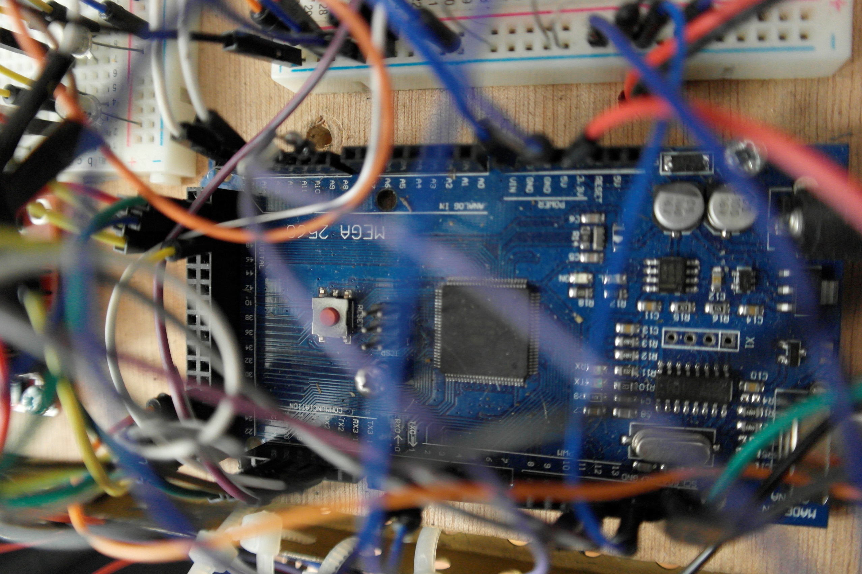
Software
ApeRobot documentation

Slide 19
Software Architecture
Windows / Octave
Computational Layer
Localize Robot & Manage Robot Trajectory
Windows / Java
Command Layer
Manage Instructions
&
Information
with Arduino
Arduino / C++
Physical layer
Monitor & Control Hardware Components
WIFI UDP / Serial Gateway
I2C bus
Object communication

Slide 20
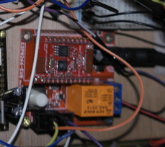
The WIFI UDP/Serial Gateway
Based on ESP8266 micro-controler
Developped with Arduino IDE
Act as a gateway
From UDP to Serial
From Serial to UDP
Route any ascii trame
Route any two binary consecutive bytes
Code available on GitHub

Slide 21
The Inertial Mouvement Sub-system

Slide 22
The Octave Main Functions
Java interaction
Initialize
Create java object
Launch java batch
robot.SetTraceFileOn(true)
Echo location
Servo-motor
RobotAlignServo(degre)
Ping
Scan360
PingEchoFrontBack
Get result
GetScanAngle(x)
GetScanFrontDist(x)
GetScanBackDist(x)
Move
Move(rotation,distance)
NorthAlign(NO)
Robot Location
GetNorthOrientation() arduino data
GetHardPosX() arduino data
GetHardPosY() arduino data
GetHardAngle() arduino data
SetPosX(value) java data
SetPosY(value) java data
SetHeading(value) java data
ValidHardPosition() update java data with arduino data
UpdateHardRobotLocation() update arduino data with java data

Slide 23
The Octave Main Functions
Localization
Cartography
QueryCartoAvailability(carto1,xIn,yIn,heading,debugOn)
Check if a location is possible taking into account physical characteristics
Echo analyze
EchoLocalizeRobotWithRotation(robot,nbLocPossibility,x,heading)
IA analyze last echo scan to determine the x most likely robot position according to the heading
TestLocationEchoConsistancy(robot,carto,posX,posY,heading)
Analyse 4 x 90° echo to compute location probality taking into account specific cartography points
Particles
CreateLocatedParticles(carto,posX,posY,heading,locProb,particlesNumber,plotOn)
Create particles taking into account current location probability and cartography
MoveParticles(rotationToDo,lenToDo,plotOn,particles)
Moves particles with noise
DetermineRobotLocationWithParticlesGaussian(newX,newY,prob,plotOn,particles)
Find the most likely particles positions according to the new mesurments
ResampleParticles(plotOn,particles)
Resample the particles taking into account the probabilty

Slide 24
The Octave Main Functions
Trajectory
InitCurrentLocation(carto,robot)
Manualy set current location with probability
ComputeTargetLocation(carto,robot)
Manualy set target location
ComputeNextStepToTarget(carto,X,Y,heading,targetX,targetY,plotOn)
CheckStraightMovePossibility()
Check if it is possible to go straight forward
AStarSearch()
Compute a path to the target
return the next step to do
ComputeMoveToDo(robot.GetHardPosX,robot.GetHardPosY,robot.GetHardAngle,nextX,nextY)
Return rotation and distance to do to reach the next step
Global
WaitForRobot(robot,WaitForKind)
Wait for action defined by WaitForKind to be completed and provide return code

Slide 25
Axis and heading
Y axis
Servo-motor align 90°
Servo-motor align 180°
Heading
y
Back
Front
North Orientation
Servo-motor align 0°
x
X axis
North

Slide 26
Notes ping echo
1
Y
e1
3
4
180°
h
a1
e4
a2
e3
h
0°
e2
2
X

Slide 27
Notes ping echo
1
Y
e1
3
4
a1
a2
h
0°
e4
e3
180°
e2
2
X

Slide 28
Notes ping echo
1
Y
e1
3
4
0°
h
a2
e4
a1
180°
e3
e2
2
X

Slide 29
Notes ping echo
1
Y
e1
3
4
180°
h
e4
a2
e3
0°
a1
e2
2
X

Slide 30
Ping Echo
Si 90 < h <=180
a2=270-h a1=180-h
e1=PF(a1) e2= PB(a1)
e3=PB(a2) a4=PF(a2)
Si 0 <= h <=90
a2=90-h a1=180-h
e1=PF(a1) e2= PB(a1)
e3=PF(a2) a4=PB(a2)
Si 180 < h <=270
a1=360-h a2=270-h
e1=PB(a1) e2= PF(a1)
e3=PB(a2) a4=PF(a2)
Si 270 < h <360
a2=450-h a1=360-h
e1=PB(a1) e2= PF(a1)
e3=PF(a2) a4=PB(a2)

Slide 31
Rotations
T
Y axis
H
Back
A
Front
P’
y_r
P'
P
y_c
C
x_c
x_r
X axis
P: position initiale du robot
P’: position après rotation du robot
C: centre de rotation
H: heading initial
T: cible position robot
A: rotation pour atteindre la cible
S: distance entre C et P

Slide 32
Rotation calculs
Coordonnées: C (x_c,y_c) P (x_p,y_p) P’ (x_p’,y_p’) T(x_t,y_t)
x_c = x_p-S*cos(H) Y_c = y_p-S*sin(H)
A=atan((y_t - y_c)/(x_t – x_c))
Rot=A-H
D=racine( (x_t-x_p’)^2 + (y_t-y_p’)^2)
x_p’=x-c+S*cos(A)
Y_p’=y_c+S*sin(A)

Slide 33
Headings
Y axis
South
RelativeHeading
(used to monitor moves – IMU mode)
H
A
BNOPermanentShiftHeading
(used to eventualy adjust to physical)
BNO055
+
Location Heading
(used to locate the
Robot - NDOF & IMU mode)
+
C
North Heading
Compas mode
X axis
NorthXAverageShift
(average of north local values
– scan location)
North
North local values

